Slide 1

Computer Programming in C++ Unit-I C++ Overview

Slide 2
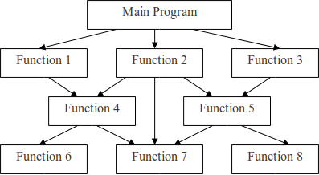
INTRODUCTION TO PROCEDURE ORIENTED PROGRAMMING
In the procedure oriented approach, the problem is viewed as the sequence of things to be done such as reading, calculating and printing such as Cobol, Fortran and c.
The primary focus is on functions. The technique of hierarchical decomposition has been used to specify the tasks to be completed for solving a problem.

Slide 3
CHARACTERISTICS OF PROCEDURE ORIENTED PROGRAMMING
Emphasis is on doing things (algorithms).
Large programs are divided into smaller programs known as functions.
Most of the functions share global data.
Data move openly around the system from function to function.
Functions transform data from one form to another.
Employs top-down approach in program design.

Slide 4
INTRODUCTION TO OBJECT ORIENTED PROGRAMMING
The major motivating factor in the invention of object-oriented approach is to remove some of the flaws encountered in the procedural approach.
OOP treats data as a critical element in the program development and does not allow it to flow freely around the system.
It ties data more closely to the function that operate on it, and protects it from accidental modification from outside function.
OOP allows decomposition of a problem into a number of entities called objects and then builds data and function around these objects.
The data of an object can be accessed only by the function associated with that object. However, function of one object can access the function of other objects.

Slide 5
FEATURES OF OBJECT ORIENTED PROGRAMMING
Emphasis is on data rather than procedure.
Programs are divided into what are known as objects.
Data structures are designed such that they characterize the objects.
Functions that operate on the data of an object are ties together in the data structure.
Data is hidden and cannot be accessed by external function.
Objects may communicate with each other through function.
New data and functions can be easily added whenever necessary.
Follows bottom up approach in program design.

Slide 6
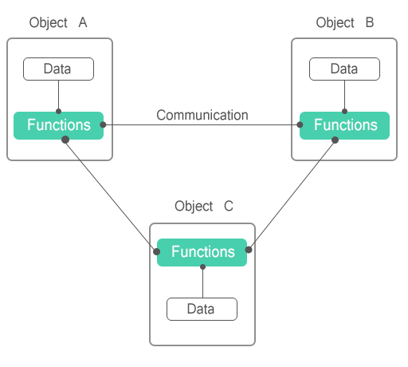
OBJECT ORIENTED PROGRAMMING PARADIGM
The major motivating factor in the invention of object-oriented approach is to remove some of the flaws encountered in the procedural approach.
OOP treats data as a critical element in the program development and does not allow it to flow freely around the system.
It ties data more closely to the function that operate on it, and protects it from accidental modification from outside function.
OOP allows decomposition of a problem into a number of entities called objects and then builds data and function around these objects.

Slide 7
TERMINOLOGY OF OBJECT ORIENTED PROGRAMMING
Object:- Objects are the basic run time entities in an object-oriented system. They may represent a person, a place, a bank account, a table of data or any item that the program has to handle. They may also represent user-defined data such as vectors, time and lists.
Classes:- We just mentioned that objects contain data, and code to manipulate that data. The entire set of data and code of an object can be made a user-defined data type with the help of class. In fact, objects are variables of the type class.
Data Abstraction:- Abstraction refers to the act of representing essential features without including the background details or explanation.
Data Encapsulation:- The wrapping up of data and function into a single unit (called class) is known as encapsulation. Data and encapsulation is the most striking feature of a class.
Data Hiding:- This insulation of the data from direct access by the program is called data hiding or information hiding

Slide 8
TERMINOLOGY OF OBJECT ORIENTED PROGRAMMING
Inheritance:- Inheritance is the process by which objects of one class acquired the properties of objects of another classes. It supports the concept of hierarchical classification. In OOP, the concept of inheritance provides the idea of reusability. This means that we can add additional features to an existing class without modifying it
Polymorphism:- Polymorphism is another important OOP concept. Polymorphism, a Greek term, means the ability to take more than on form. An operation may exhibit different behavior is different instances.
Dynamic binding:- Dynamic binding means that the code associated with a given procedure call is not known until the time of the call at run time. It is associated with polymorphism and inheritance.
Message passing:- Objects communicate with one another by sending and receiving information much the same way as people pass messages to one another. The concept of message passing makes it easier to talk about building systems that directly model or simulate their real-world counterparts.

Slide 9
THE C++ LANGUAGE
An object-oriented, general-purpose programming language, derived from C (C++ = C plus classes).
C++ adds the following to C:
Inlining and overloading of functions.
Default argument values.
Argument pass-by-reference.
Free store operators new and delete, instead of malloc() and free().
Support for object-oriented programming, through classes, information hiding, public interfaces, operator overloading, inheritance, and templates.

Slide 10
DESIGN OBJECTIVES IN C++
Compatibility. Existing code in C can be used. Even existing, pre-compiled libraries can be linked with new C++ code.
Efficiency. No additional cost for using C++. Overheadof function calls is eliminated where possible.
Strict type checking. Aids debugging, allows generation of efficient code.
C++ designed by Bjarne Stroustrup of Bell Labs (now at TAMU).
Standardization: ANSI, ISO.

Slide 11
NON OBJECT-ORIENTED EXTENSIONS TO C
Major improvements over C.
Stream I/O.
Strong typing.
Parameter passing by reference.
Default argument values.
Inlining.

Slide 12
BENEFITS OF OBJECT ORIENTED PROGRAMMING
Through inheritance, we can eliminate redundant code extend the use of existing Classes.
The principle of data hiding helps the programmer to build secure program that can not be invaded by code in other parts of a programs.
It is possible to have multiple instances of an object to co-exist without any interference.
Object-oriented system can be easily upgraded from small to large system.
Message passing techniques for communication between objects makes to interface descriptions with external systems much simpler.
Software complexity can be easily managed.
It is easy to partition the work in a project based on objects.
The data-centered design approach enables us to capture more detail of a model can implemental form.

Slide 13
APPLICATIONS OF OBJECT ORIENTED PROGRAMMING
The promising areas of application of OOP include:
Real-time system
Simulation and modeling
Object-oriented data bases
Hypertext, Hypermedia, and expertext
AI and expert systems
Neural networks and parallel programming
Decision support and office automation systems
CIM/CAM/CAD systems

Slide 14
FUNCTION DEFINITION AND DECLARATION
In C++, a function must be defined prior to it’s use in the program. The function definition contains the code for the function.
The general syntax of a function definition in C++ is shown below:
Type name_of_the_function (argument list)
{
//body of the function
}
For Example:- /function definition
add()
void add(int a, int b) //variable names are must in definition
{
int sum;
sum=a+b;
cout<<”\nThe sum of two numbers is “<<sum<<endl;
}

Slide 15
VARIABLE DECLARATION IN C++
In C++,all the variables that a program is going to use must be declared prior to use.
Declaration of a variable serves two purposes:
It associates a type and an identifier (or name) with the variable. The type allows the compiler to interpret statements correctly.
It allows the compiler to decide how much storage space to allocate for storage of the value associated with the identifier and to assign an address for each variable which can be used in code generation.
The variable declaration has the form:-
type-identifier list;
For example:- int a;

Slide 16
O-O PRINCIPLES AND C++ CONSTRUCTS
O-O Concept C++ Construct(s)
Abstraction Classes
Encapsulation Classes
Information Hiding Public and Private Members
Polymorphism Operator overloading,
templates, virtual functions
Inheritance Derived Classes

Slide 17
ADVANTAGES OF OOPS
Modularity for easier troubleshooting. Something has gone wrong, and you have no idea where to look. ...
Reuse of code through inheritance. ...
Flexibility through polymorphism. ...
Effective problem solving

